Slide 1
Introduction to R Workshop
Advanced Reporting
July 17, 2020

Slide 2
Goals
Develop dashboards using the flexdashboard package
Add interactive plot elements to existing ggplots
Objectives
Build R Markdown reports using formatting outputs beyond standard document formats
Incorporate packages to create interactive plots
Use parameters to further automate reporting

Slide 3
Typical Data Science Pipeline
From R for Data Science (https://r4ds.had.co.nz/introduction.html)
Notes:
We refer to R for Data Science, a free text available online frequently
Provide a nice model for the typical process of analyzing data to communicate
Focus for this hour is the machinery that allows us to capture this whole process in a way that is reproducible and also can communicate to others

Slide 4
R Markdown Output Comes in Many Flavors

Slide 5
Standard Markdown Reporting Formats
HTML file - open with any web browser
PDF – requires LaTeX dependencies (install tinytex package)
Word – default format for collaborating with those who aren’t familiar with R

Slide 6
Formats to go straight from code to slides
Multiple HTML formats create webpage that’s advanceable like slides
PDF presentation uses LaTeX in the background
Powerpoint produces simple slides

Slide 7
Output format
Each slide has its own header

Slide 8
R Markdown
This is an R Markdown presentation. Markdown is a simple formatting syntax for authoring HTML, PDF, and MS Word documents. For more details on using R Markdown see http://rmarkdown.rstudio.com.
When you click the Knit button a document will be generated that includes both content as well as the output of any embedded R code chunks within the document.
Example output slide

Slide 9
Slide with Bullets
Bullet 1
Bullet 2
Bullet 3
Example output slide

Slide 10
Slide with R Output
summary(cars)
## speed dist ## Min. : 4.0 Min. : 2.00 ## 1st Qu.:12.0 1st Qu.: 26.00 ## Median :15.0 Median : 36.00 ## Mean :15.4 Mean : 42.98 ## 3rd Qu.:19.0 3rd Qu.: 56.00 ## Max. :25.0 Max. :120.00
Example output slide

Slide 11
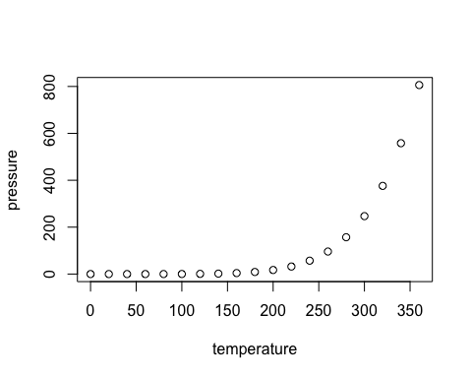
Slide with Plot
Example output slide

Slide 12
Books and longer documents also generated from R Markdown
Can generate printer ready books and ebooks
Supports LaTeX features such as equations
Generates blog formatted websites
https://github.com/rstudio/bookdown
https://bookdown.org/yihui/bookdown/
https://bookdown.org/yihui/blogdown/

Slide 13
From R Markdown to Quick and Painless Dashboards

Slide 14
Dashboards to drive improvement
Dashboards are a graphical interface to display key performance indicators or other metrics
Intended to represent multiple pieces of information at a glance

Slide 15
flexdashboard provides easy dashboard templates for reporting
Produces HTML file that can be opened on web browsers
Or deployed on existing web server
Provides row or column based layouts
Get started by running: install.packages("flexdashboard")
https://rmarkdown.rstudio.com/flexdashboard/

Slide 16
flexdashboard output format
layout page by columns
define width
title for chart
delimits separate columns

Slide 20
Your Turn #1
Open “Advanced Reporting.Rmd” to work with a draft COVID-19 flexdashboard and run the setup chunk
Too much information is crunched on the right side. Change the layout from columns to a scrolling vertical layout.

Slide 21
Other customizations
Themes
Multiple pages

Slide 22
Making plots and tables interactive

Slide 24
Goals
Develop dashboards using the flexdashboard package
Add interactive plot elements to existing ggplots
Objectives
Build R Markdown reports using formatting outputs beyond standard document formats
Incorporate packages to create interactive plots
Use parameters to further automate reporting

